Slide 1
Project Title :-
Secure Network Deployment with DMZ, iptables, Snort IDS, and Centralized Monitoring using Nagios
Project by :
Astha Bhende
(240344223042)

Slide 2
Introduction
The goal of this project is to design and implement a secure, multi-layered network architecture that hosts a web-based Flask application, a mail server, and a database server. Security is enforced through the use of iptables firewalls, fail2ban, and Snort IDS. Centralized monitoring is accomplished using Nagios XI to ensure availability, performance, and alerting.

Slide 3
Objective
Deploy a web application in a secure DMZ.
Setup and secure mail and database servers.
Monitor system services using Nagios XI.
Implement intrusion detection and SSH protection.
Use iptables to enforce network-level access restrictions.

Slide 4
Network Architecture
DMZ Network:
Web Server: Hosts the Flask-based TODO app
Mail Server: Manages internal mail using Postfix and Dovecot
Private Network:
Database Server: Accessible only from Web Server via iptables
Monitoring Network:
Nagios XI: Monitors all critical services and sends alerts
Security Tools:
iptables: Restricts network access
Snort IDS: Detects network intrusions

Slide 5
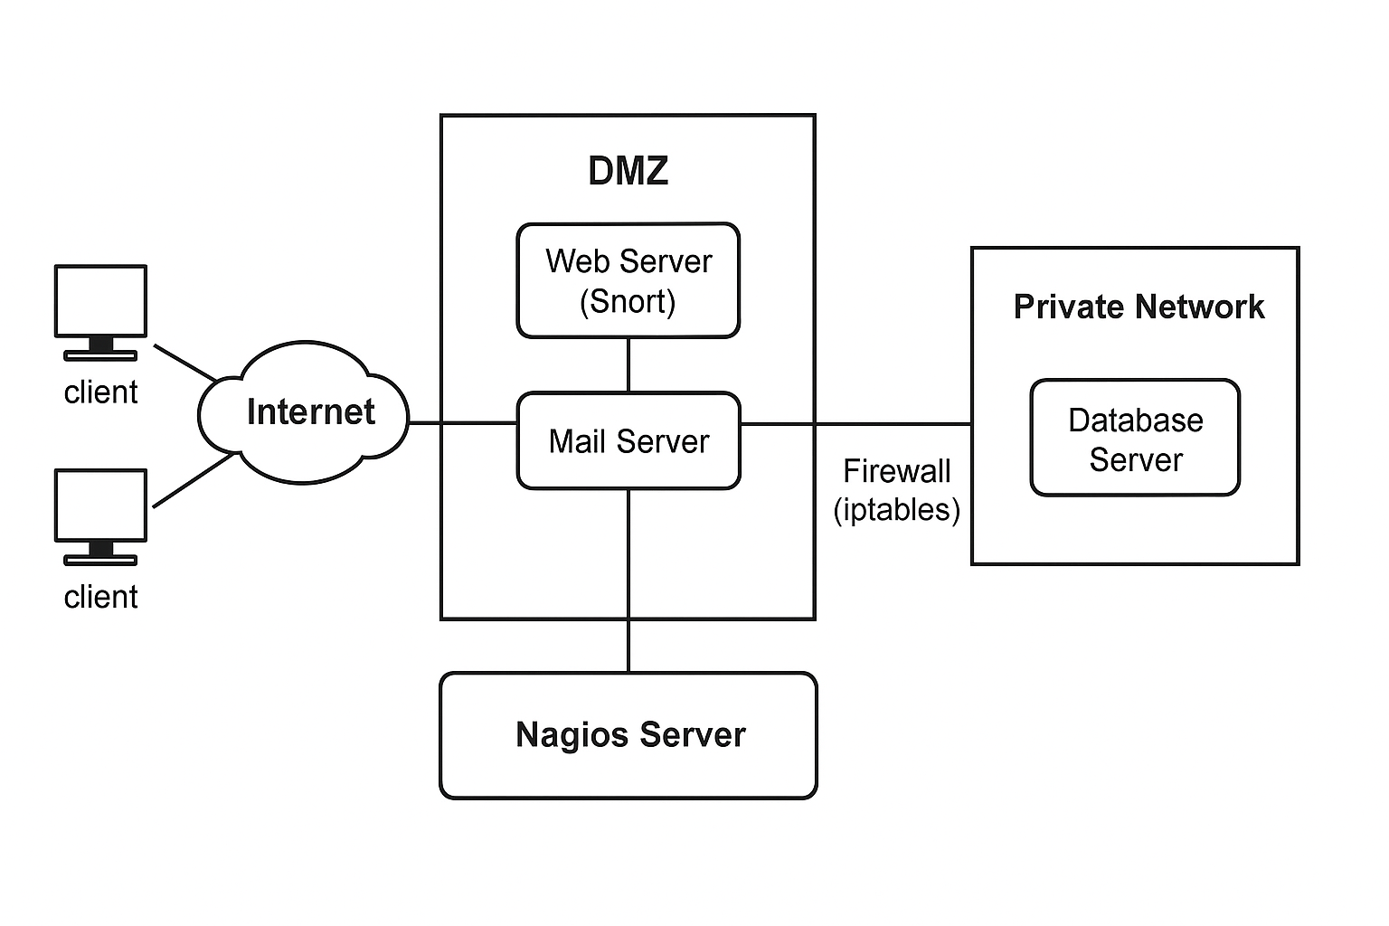
Architecture Diagram :

Slide 6
Web Application Setup
Cloned from GitHub: https://github.com/sunbeam-ditiss/KartvyaPath-Project.git
Flask app deployed on Apache2/Nginx
HTTPS setup with certificates for todo.sunbeam.local
Connected securely to DB Server

Slide 7
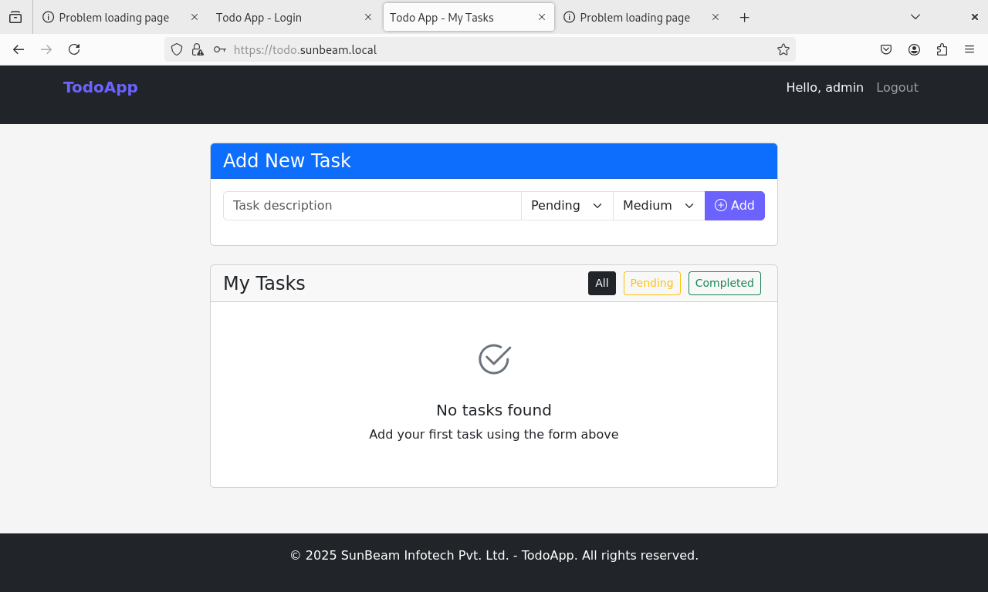

Slide 8
Mail Server Setup
Tools used: Postfix + Dovecot
Domain: sunbeam.local
Webmail client: Roundcube
Accessible at: http://mail.sunbeam.local
Two test user accounts created

Slide 9
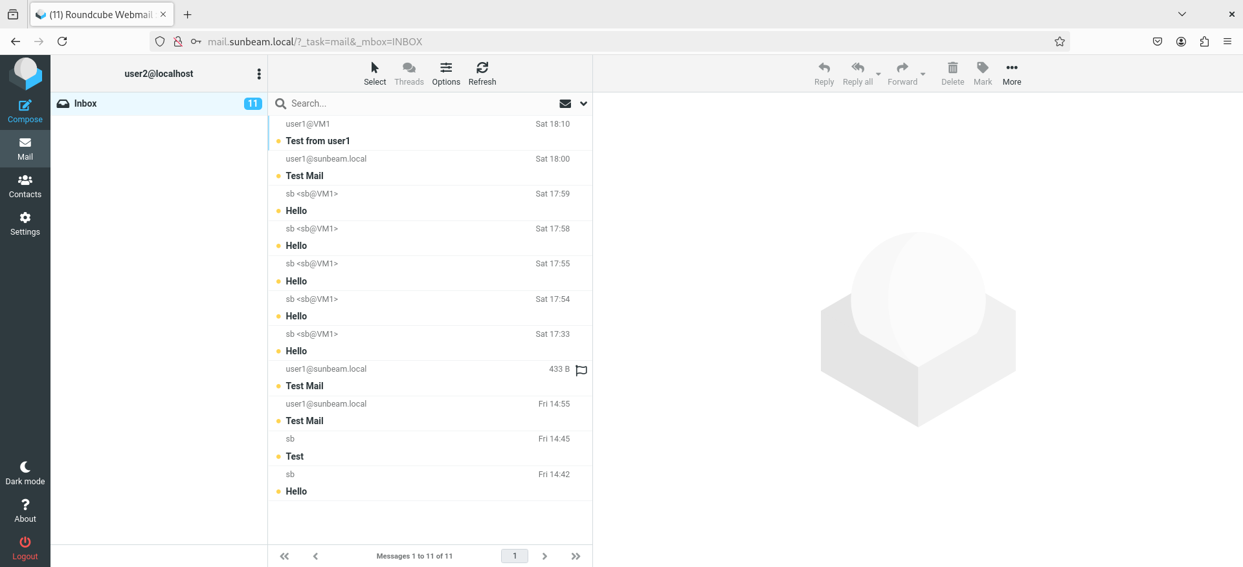

Slide 10
Database Server Configuration
MySQL or PostgreSQL used
DB server in private subnet
Only allows connection from Web Server (using iptables)

Slide 11
Monitoring with Nagios XI
Nagios is an open-source monitoring system that provides comprehensive monitoring and alerting capabilities for IT infrastructure components. It helps organizations monitor the health and performance of their networks, servers, applications, and services, enabling proactive identification and resolution of issues before they impact business operations
Nagios XI installed on a dedicated server
Monitored Services:
HTTP, HTTPS, Apache, SMTP, IMAP, POP3
CPU, Memory usage on all servers
Alerts sent to mail server (sunbeam.local)

Slide 12
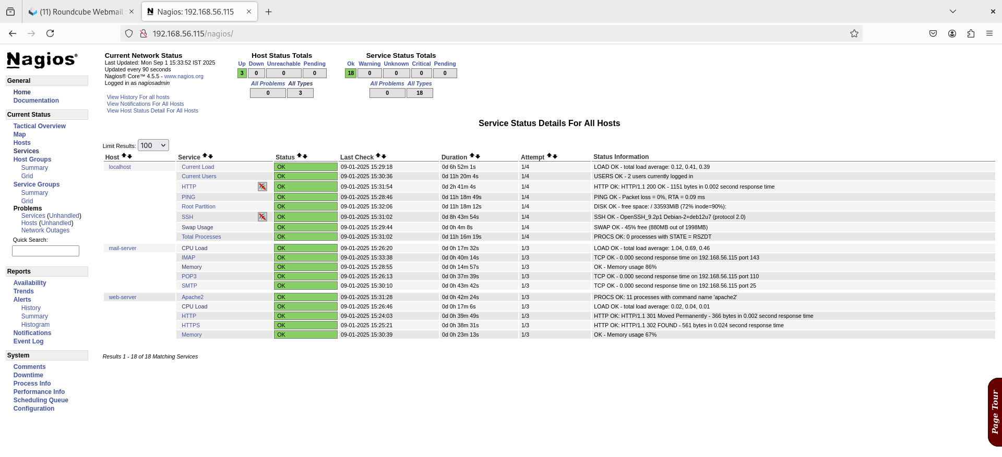

Slide 13
Security Hardening
Snort IDS:
Detects SYN Flood, Ping Flood, Ping of Death
fail2ban:
Blocks SSH brute-force attempts
iptables:
Firewall rules to control access
DB server only accessible from Web Server

Slide 14
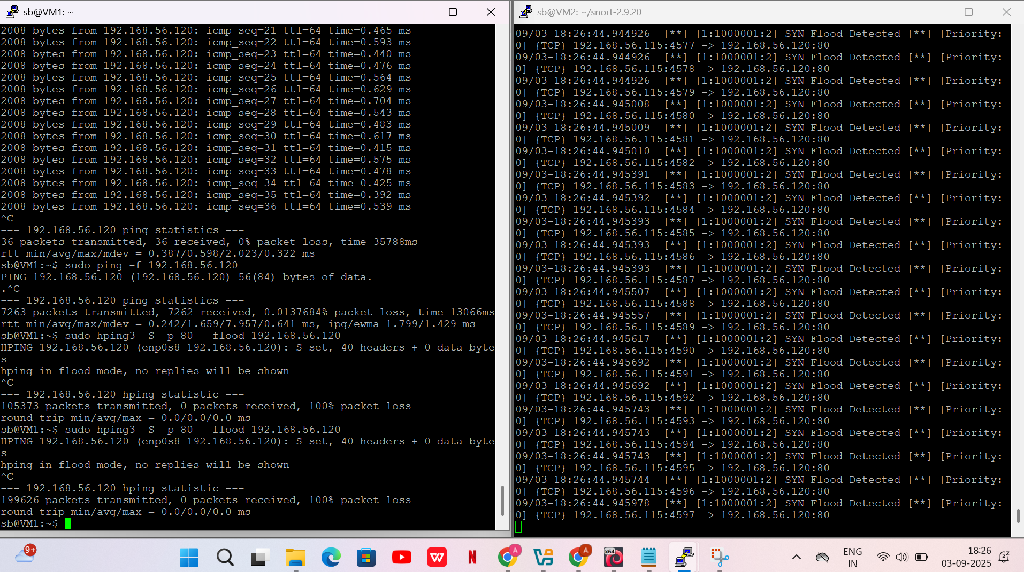
Syn flood

Slide 15
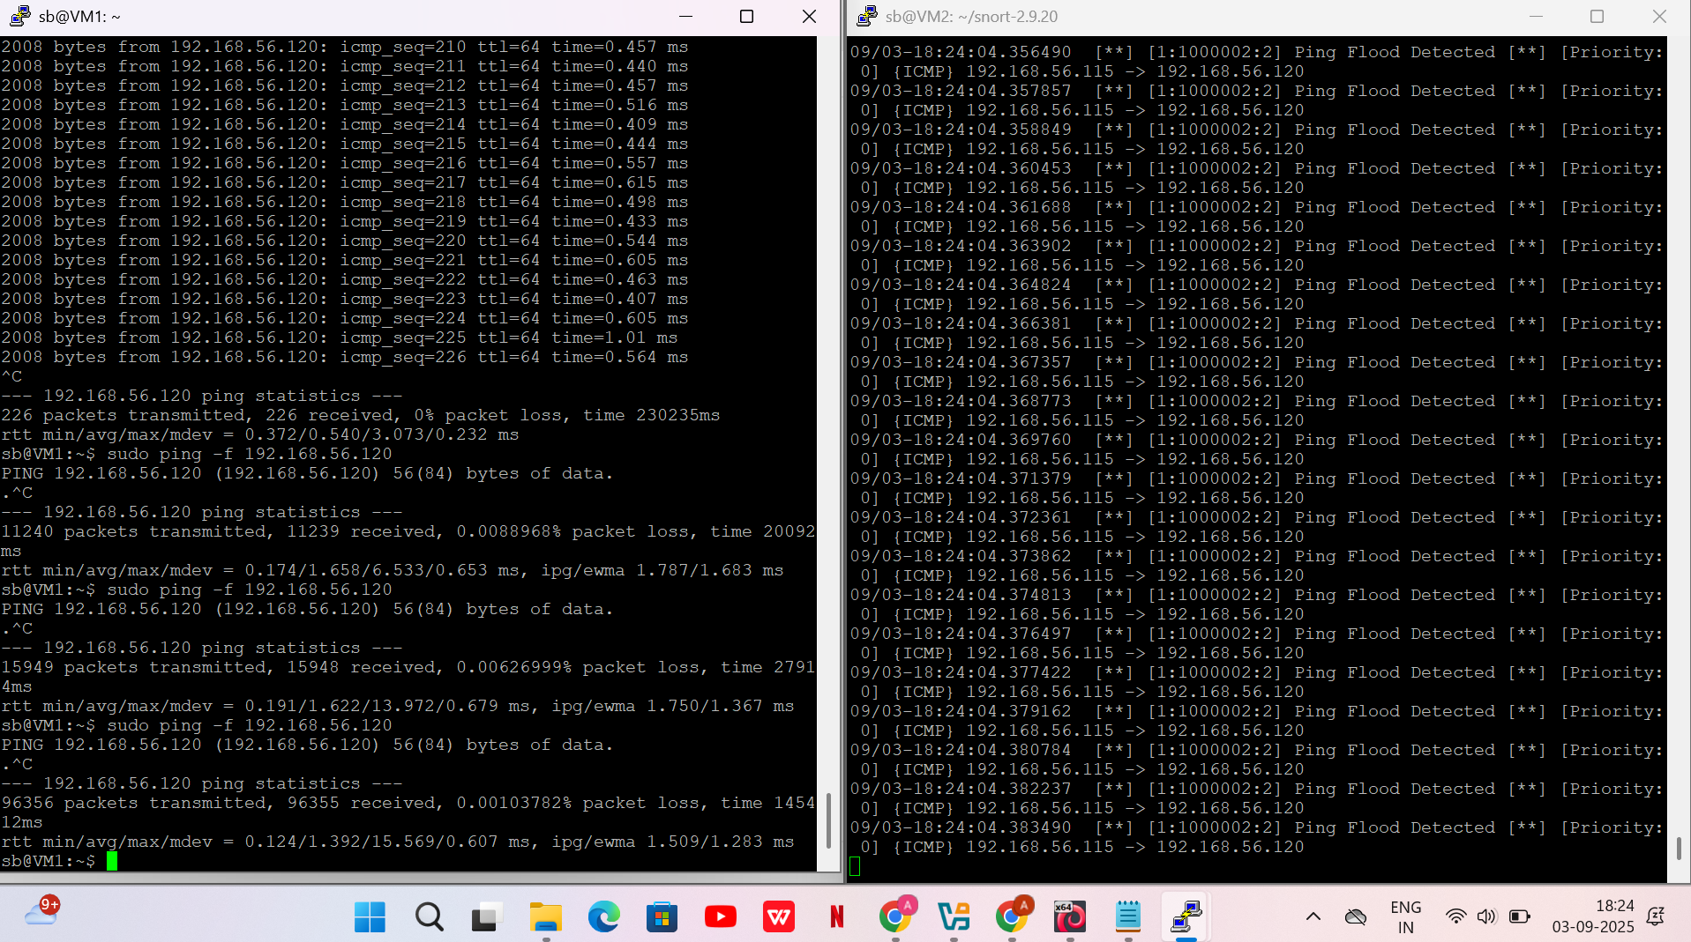
Ping flood

Slide 16
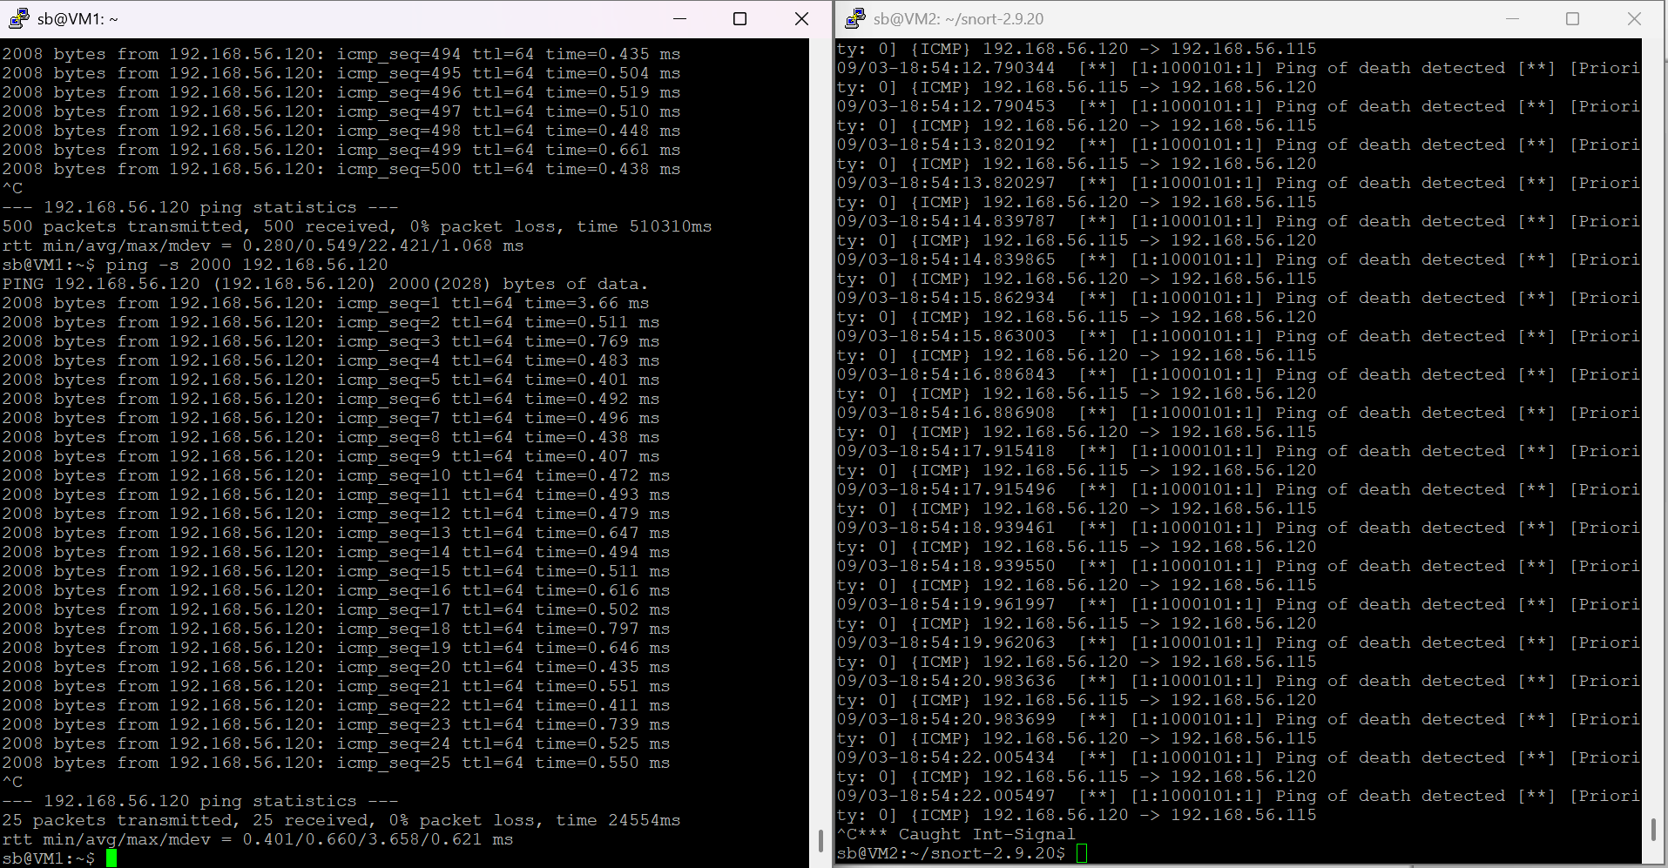
Ping of Death

Slide 17
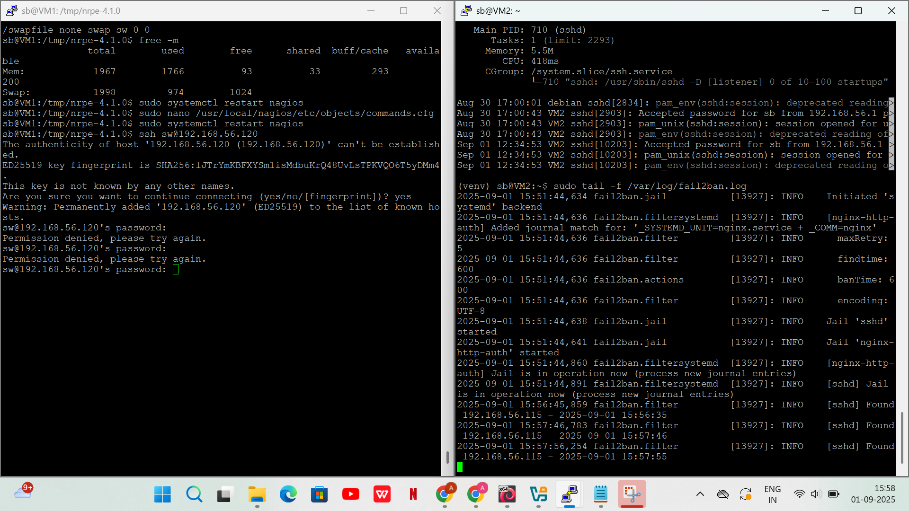
Fail2ban

Slide 18
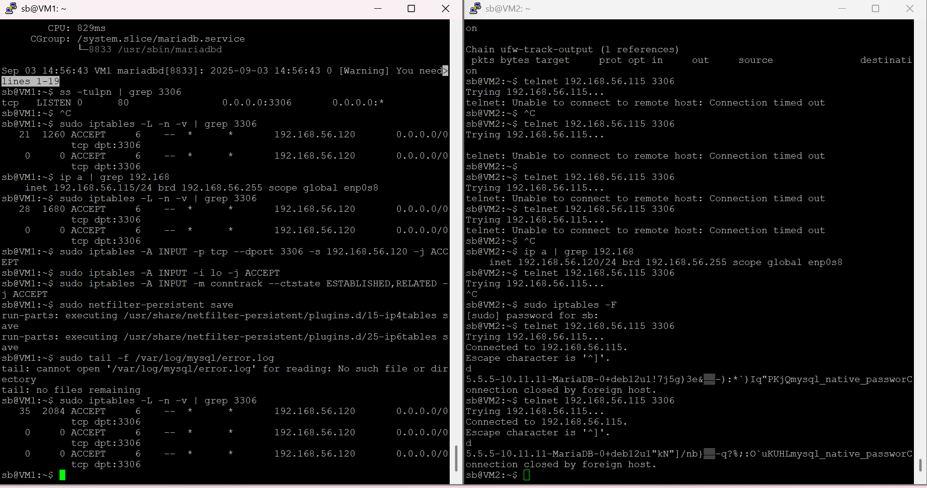
Firewall -iptables

Slide 19
Testing & Validation
Application accessed via https://todo.sunbeam.local.
Emails sent and received via mail.sunbeam.local.
Nagios verified to send alerts upon service failures.
Snort IDS tested using simulated attacks.
fail2ban tested with brute-force attempts.

Slide 20
Tools & Technologies Used
Web Application: Flask, Apache2, SSL/TLS
Database: MySQL / PostgreSQL
Mail Server: Postfix, Dovecot, Roundcube
Monitoring: Nagios XI
Security: Snort IDS, fail2ban, iptables
Domain Setup: /etc/hosts or Local DNS
Operating System: Ubuntu Server 20.04 / Debian

Slide 21
Conclusion
The project successfully delivers a secure, monitored, and fault-tolerant infrastructure for deploying a web application. By segmenting the network using a DMZ and private zones, and applying layered security with Snort IDS, fail2ban, and iptables, the system is resilient to attacks and failures. Monitoring through Nagios ensures proactive issue detection and alerting.

Slide 22
Thank You

